Slide 1
Hospitality in an Age of Fear
Jonathan Hanegan
Latin American Theological Workshop

Slide 2
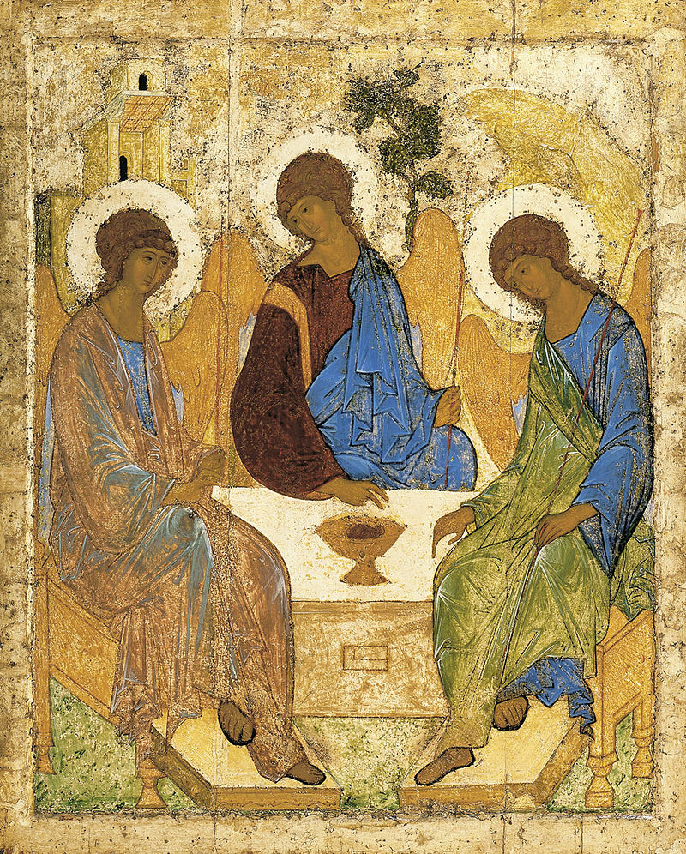
In the beginning . . .
God, through His generous hospitality, made creation a means by which we might have communion with Him.

Slide 3
He gave us a home and He gave us food as gifts.
These gifts led us to Him.

Slide 4
The only forbidden food was that which would lead us far from Him.

Slide 5
Adam & Eve chose the forbidden food and since then, we have been in exile, far from home and very hungry.

Slide 6
The creation no longer serves as a means to commune with God for it has dominated us.

Slide 7
Nevertheless, God is redeeming all of creation and calls us to be a part of its redemption.

Slide 8
How does hospitality fit into God’s plan for the redemption of all creation?

Slide 9
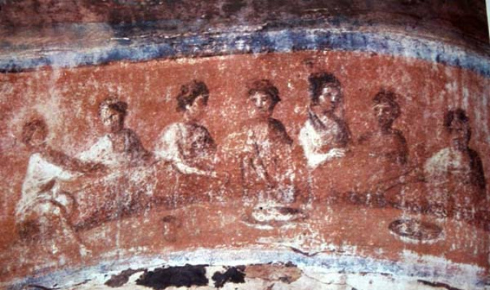

Slide 10
We need to invite people,
through the use of home and food, to commune with the Creator.

Slide 11
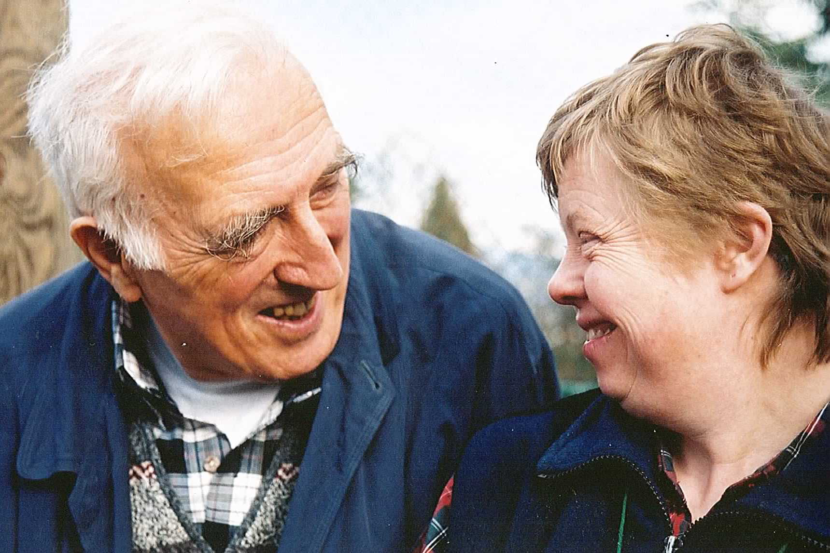
Toute personne est une histoire sacrée
Jean Vanier

Slide 12
Why is everyone sacred?
We were born of love for love.

Slide 13
3 Myths about Hospitality

Slide 14
Myth #1
You must impress your company.

Slide 15
Myth #2
You must entertain your company.

Slide 16
Myth #3
You must make a good impression.

Slide 17
The Lord visited Abraham & Sarah
Genesis 18:1-8

Slide 18
We might be entertaining angels
Hebrews 13:2

Slide 19
Hospitality with the least of these
Matthew 25:31-46

Slide 20
God visited Abraham.
Christ visits us.

Slide 21
Where does Jesus show up today?

Slide 22
2 motives for hospitality:
1. We encounter Jesus in the needy and oppressed.
2. We participate in the redemption of all of creation.

Slide 23
5 Virtues of a Hospitable Christian

Slide 24
A hospitable Christian
worships the true God

Slide 25
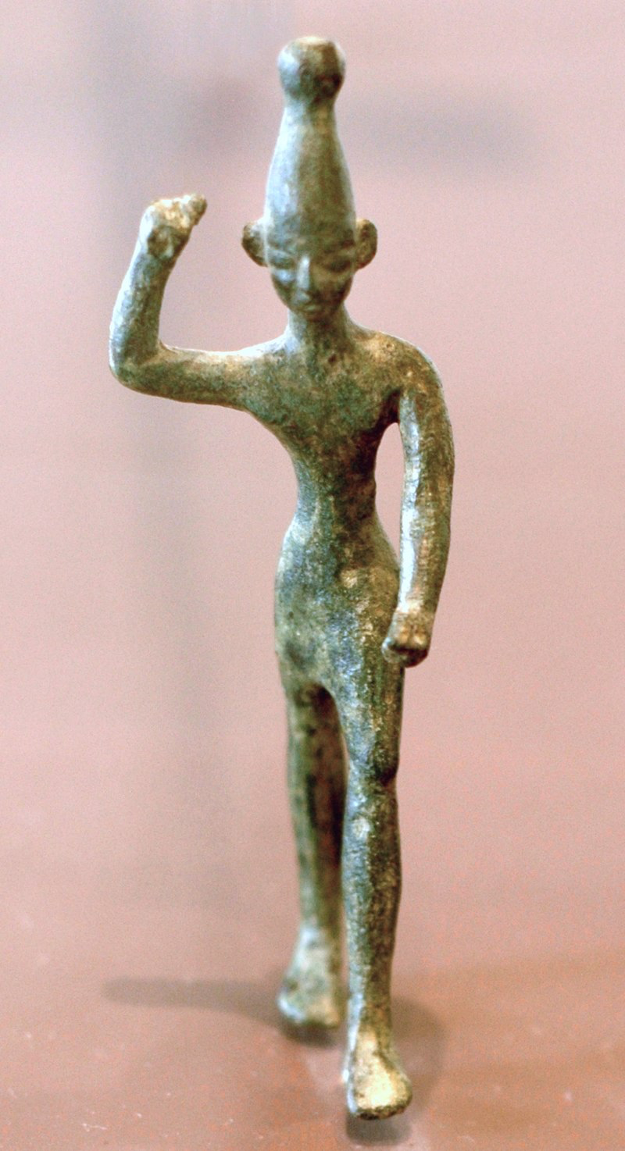
Idol worship always leads to dehumanization and oppression.

Slide 26
A hospitable Christian
deconstructs prejudice

Slide 27
Exercises in empathy:
reading, ethnographic interviews

Slide 28
A hospitable Christian
is vulnerable and transparent

Slide 29
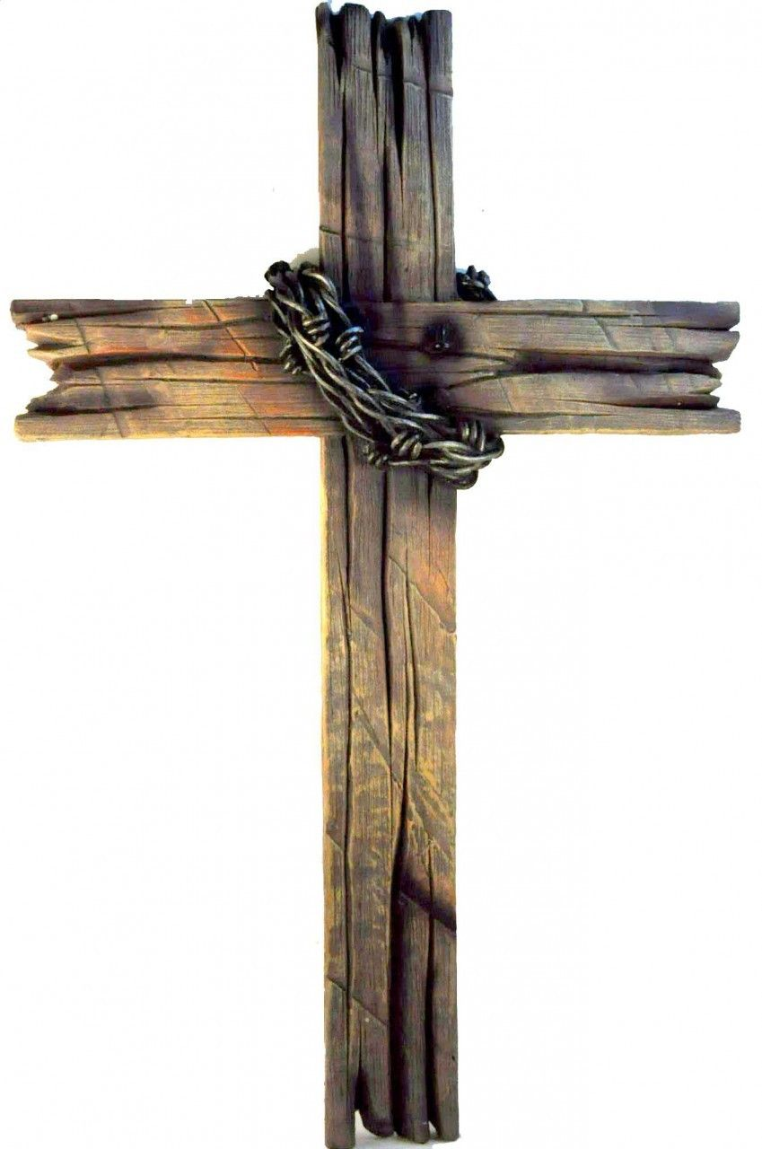
Give people something better than yourself:
be Jesus!

Slide 30
A hospitable Christian
loves courageously

Slide 31
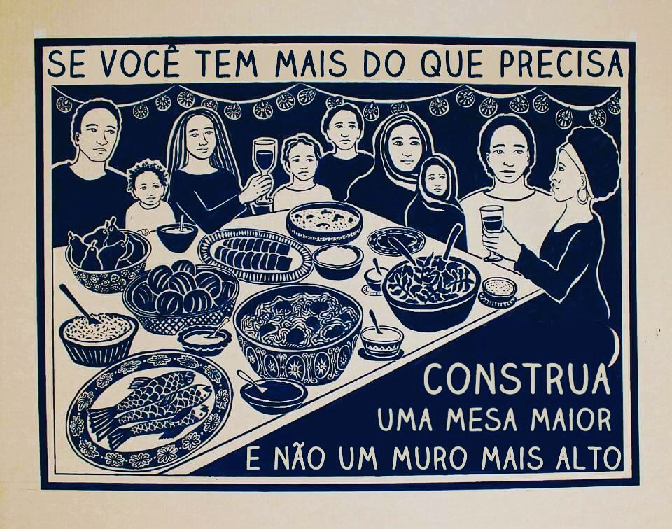
If you have more than you need, build a bigger table and not a higher wall.

Slide 32
A hospitable Christian
follows Jesus to the cross

Slide 33
We have died to ourselves and to this world in order to follow a self-sacrificing and giving Master.
Let us invite others to join Jesus at our Father’s table!

